Slide 1
___________________________ ______________
Name Prefix
____________________ _____________________
Job Species
_____________________ _____________________
Negative trait Positive trait
STR
KNO
NIM
CLE
CON
SOC
KNO | CLE | SOC
O History O Technical O Natural O Magical | O Perception O Reaction | O Insight O Intimidation O Persuasion
PB

Slide 2

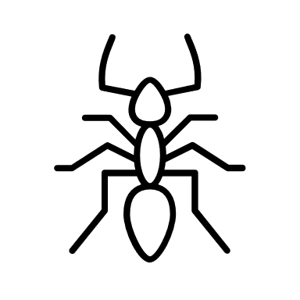


COMBAT
ACY
H-PR-M
/
General HP
/
Head-HP
Speed
REA
/
Arm-HP
/
Leg-HP
Status Effects
/
Upper-Body-HP
/
Armor
/
Shield
Attacks

Slide 3
MENTAL HEALTH
O Aggressiv
O Ängstlich
Adrenallin
/
Mental HP
Rage O O O
Fear O O O
LEVELLING
Stat Lvl
/
ATK
/
CON
/
BRAIN
/
SOC
/
Job Lvl
/
Magic Lvl

